Slide 1
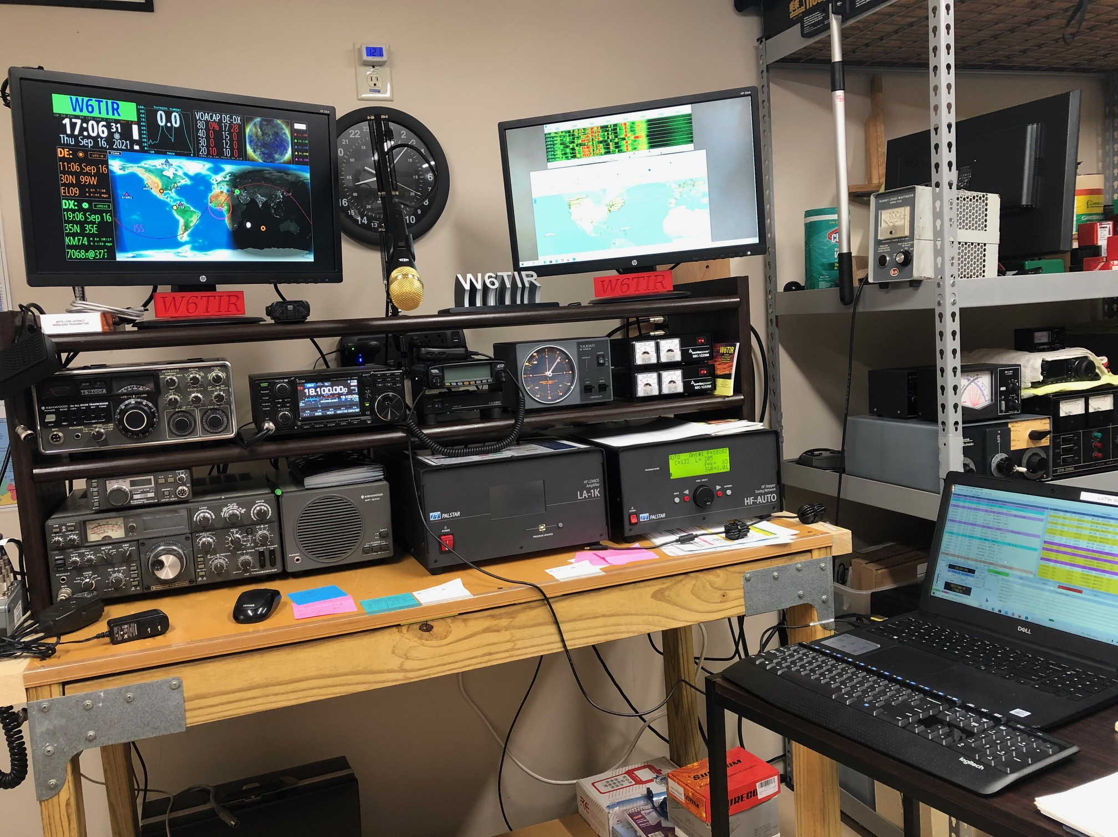
2024 W6TIR Shack Remodel
Objectives:
Modernize
Simplify
Organize
Obstacles:
Design & Construction

Slide 2
W6TIR
Shack Remodel Objectives
Modernize Station for Comfort & Ease of Operation
(standard desk height)
Organize as Legacy & Modern working stations
Organize cabling for easy change/replacement & out of sight
Simplify AC/DC Power Distribution (accessible, surge & short protection)
Increase Working Space
Relocate Boom Mic. Keep Foot Switch for HF Radios
Easy Access to Antenna Switch
Add 2nd remote controlled antenna disconnect relay
Locate Linear to Control Fan Noise. Add additional Cooling
Upgrade Monitors
Replace Laptop with Dedicated Mini Computer
Add Dedicated Micro Computer for Ham Clock

Slide 3
Obstacles
Design and Construction?
Space needed?
Drawer Space Y/N ?
How to Ground Equipment?
AC/DC Power?
Hide Cables?
Most of all-Building the Thing !!!!!

Slide 4
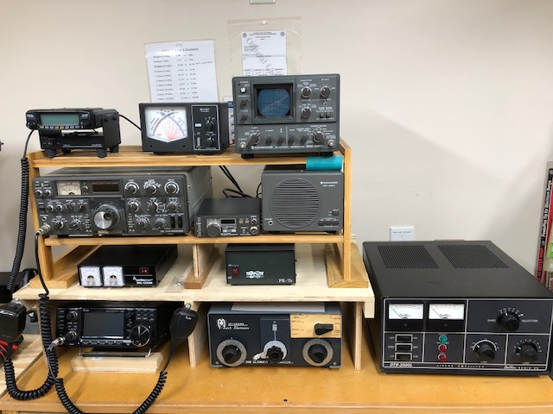
This is where W6TIR started
June 2019
Legacy Station
Kenwood TS830s
Murch 2Kw Tuner
Dentron DTR-2000L 1500 watt Amp
Kenwood Station
Monitor
Kenwood Speaker
Kenwood DFC-230
Remote VFO
Modern Station
Icom 7300
Yaesu FTM-100DR
Yaesu SBM-201 fan
MFJ-891 SWR/PWR
Meter
Samlex DC Pwr Supply

Slide 5
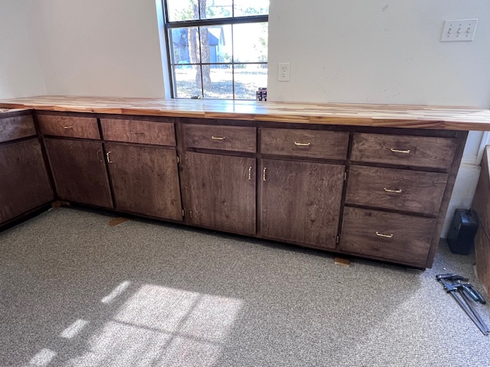
After discussions with Jerry N5SGM and seeing his new shack that he and Marsh built !!!
It was decided together we could build a new desk for my shack
Construction began in May 2024 with purchase of a raw 8’x2” butcher block from Habitat for Humanity

Slide 6
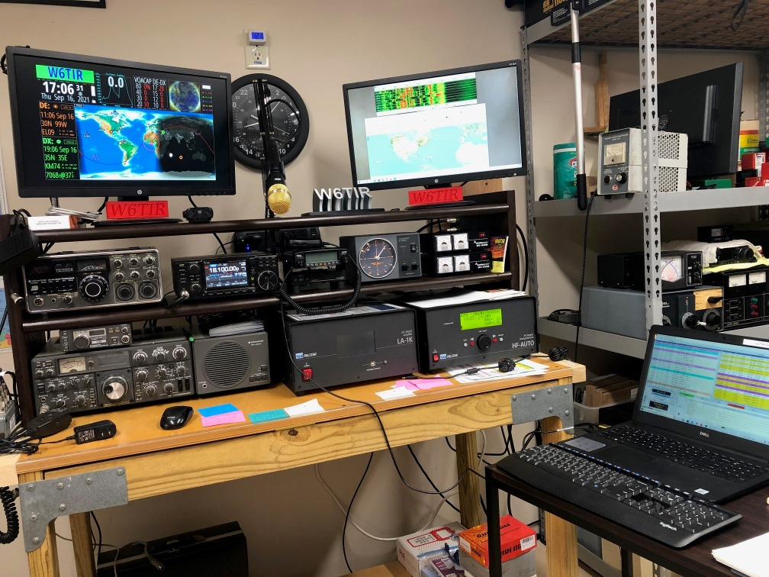
W6TIR as Renew Started
WHAT
A
MESS!
Bench was my
Old brass prep bench for reloading. 2x4’s and metal
Plates to hold it all together.
Side Table to serve as a work station for laptop.
NOT
Convenient

Slide 7
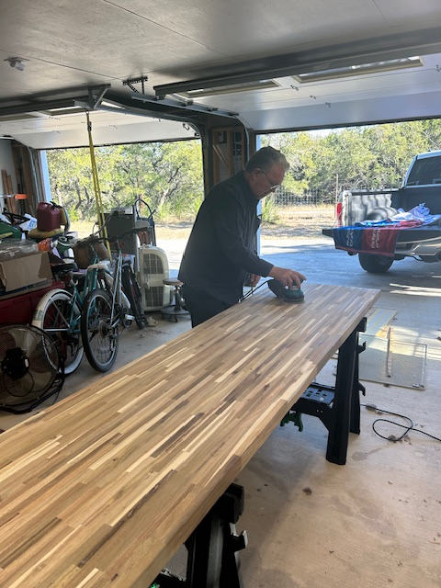
Prepping the Butcher Block
Sanding, Sanding, Sanding then Sanding some more!!!
Spent many hours sanding the butcher block. Had to fill voids in it as it was a second bought from Habitat for Humanity
Butcher Block turned out pretty nice after multiple coats of tung oil finish applied.

Slide 8
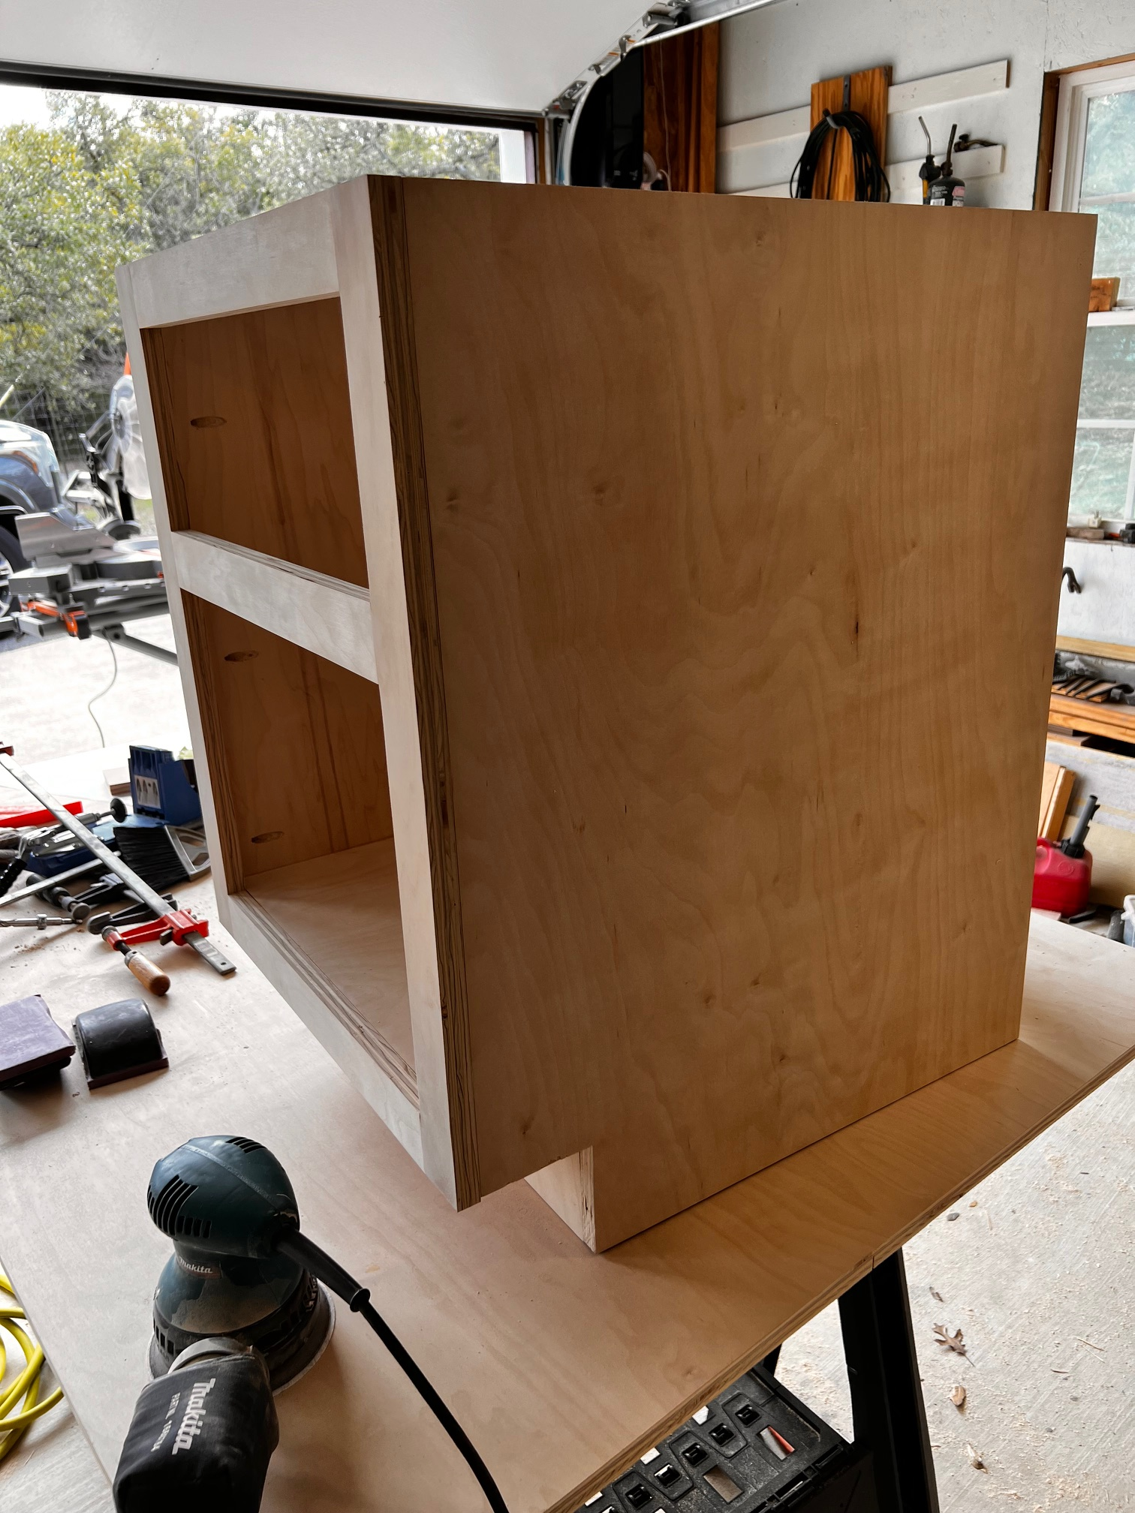
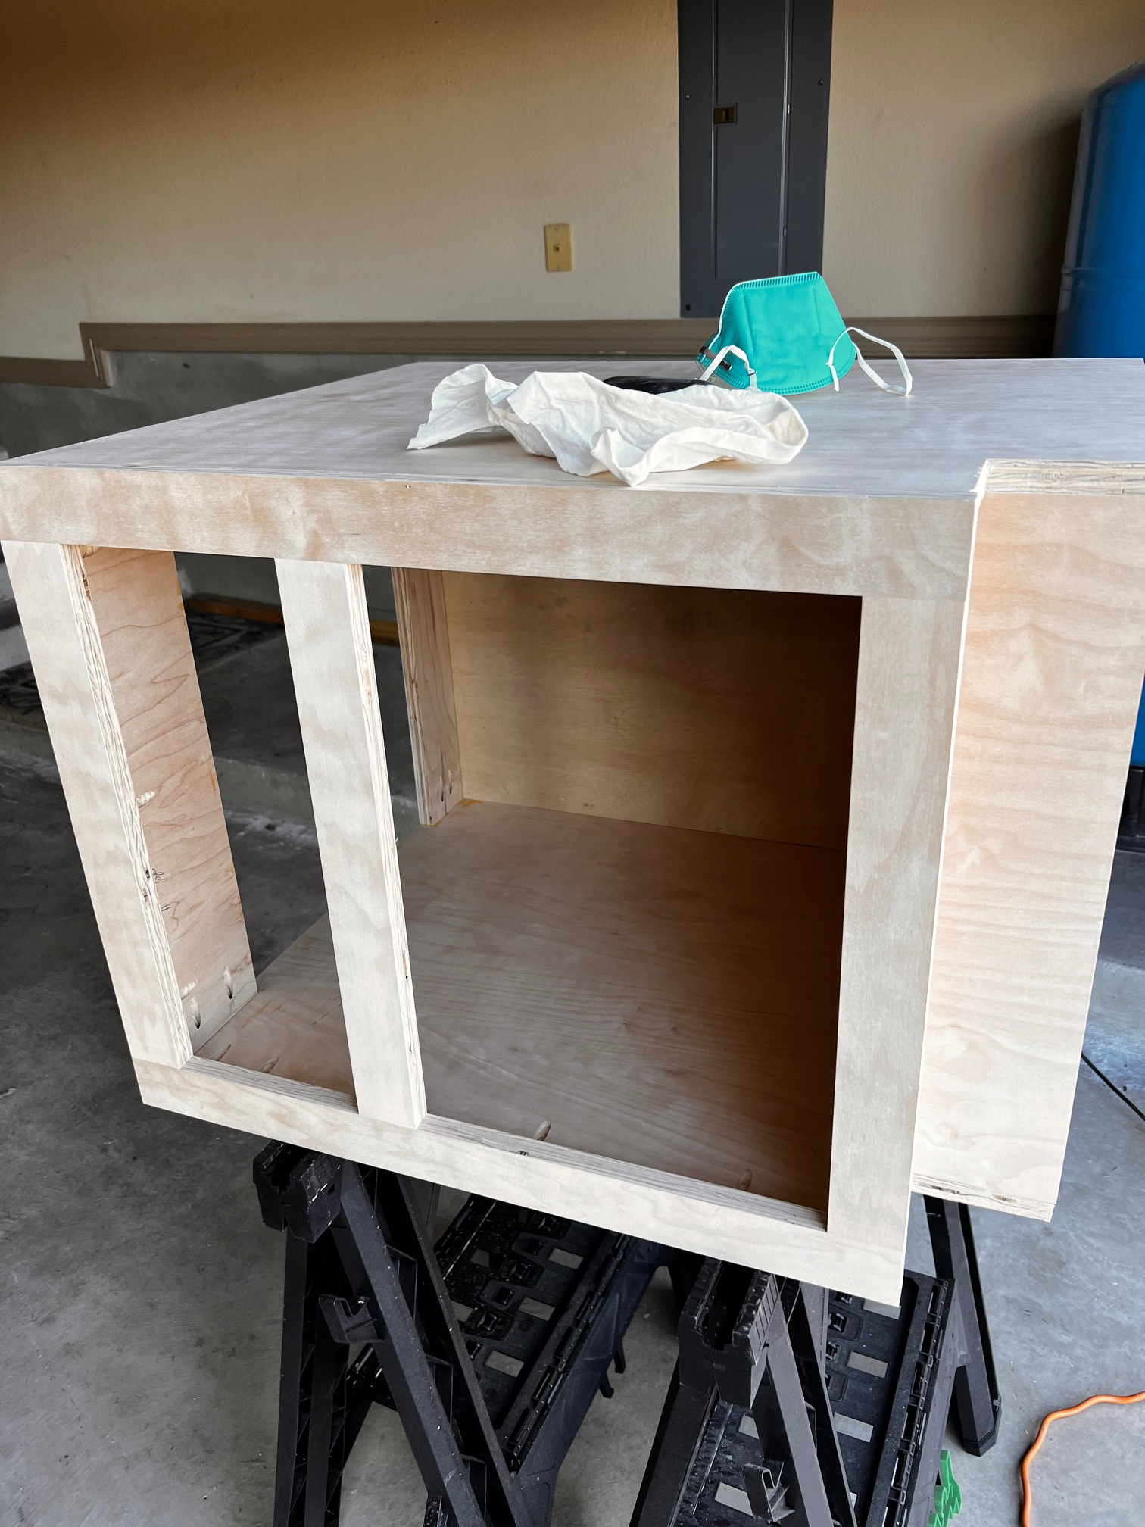
Building the Cabinets (more sanding)

Slide 9
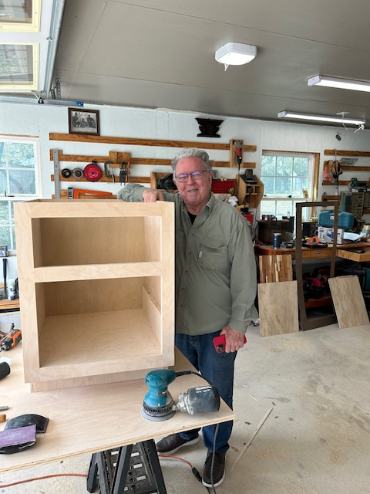
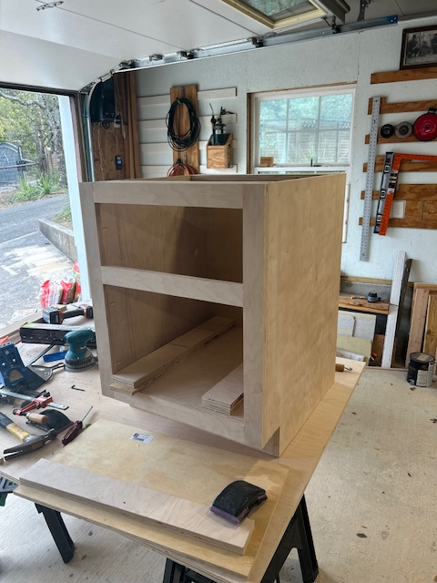
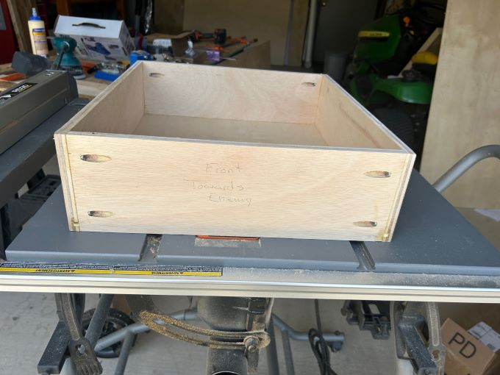
All this was done in Jerry’s shop with a table saw & chop saw.
All sanded by small orbital sander or by hand with sanding block
All wood finished with stain then polyurethane

Slide 10
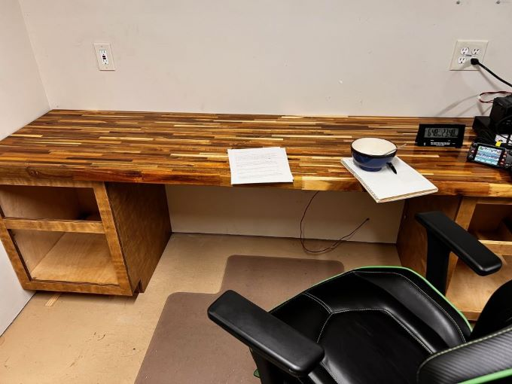
Desk starting to come together
After much sanding, staining and tung oil
Just need some drawers

Slide 11
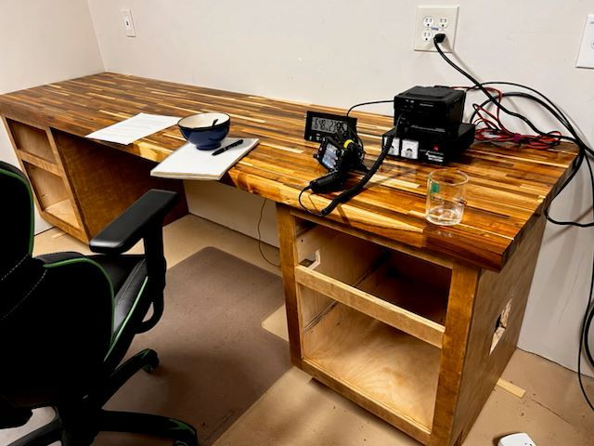
Had to have something to run the Tuesday evening net
Note the two holes in the right side drawer opening--
More on that later

Slide 12
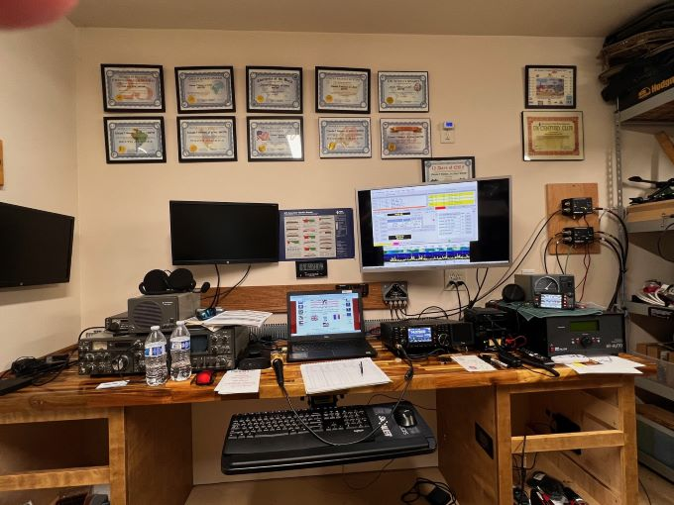
How to Clean this mess UP!

Slide 13
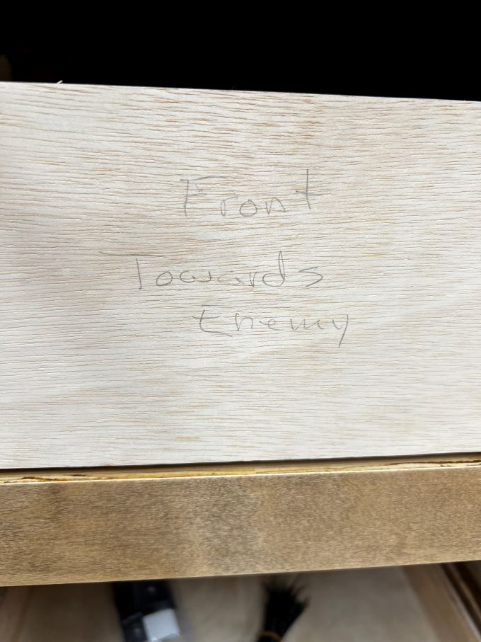
Need some Drawers
Jerry’s
Humor

Slide 14
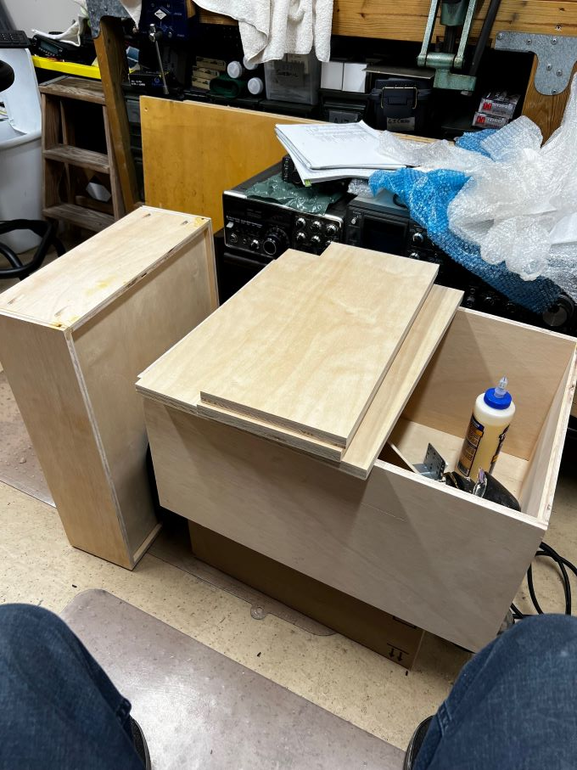
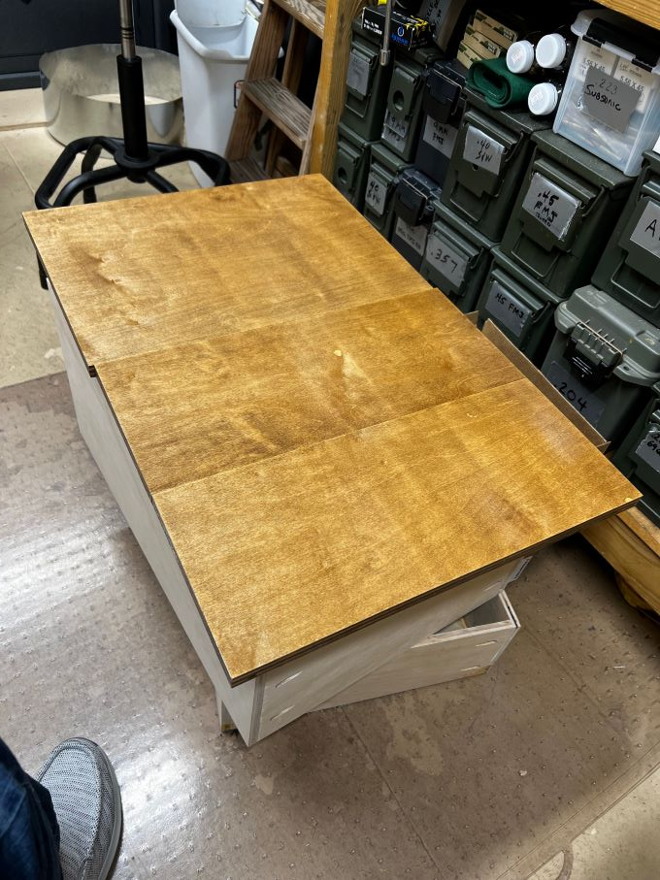
Unfinished Drawers Finished Drawer Fronts

Slide 15
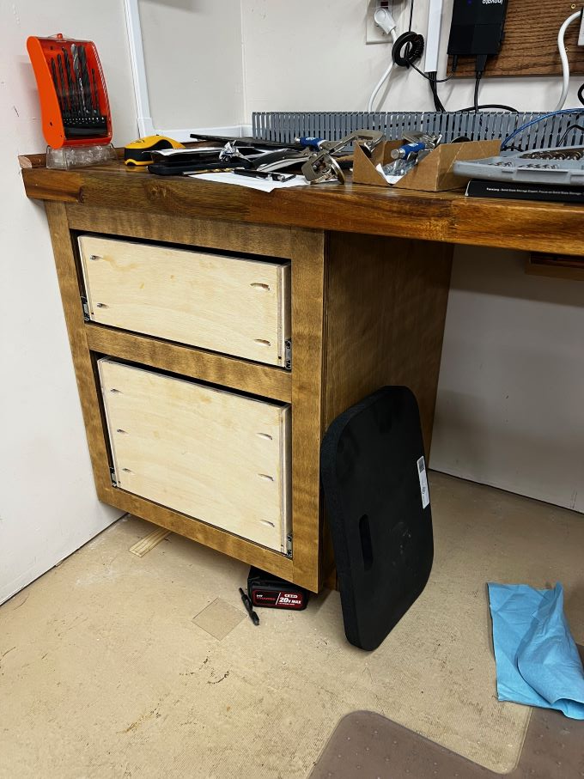
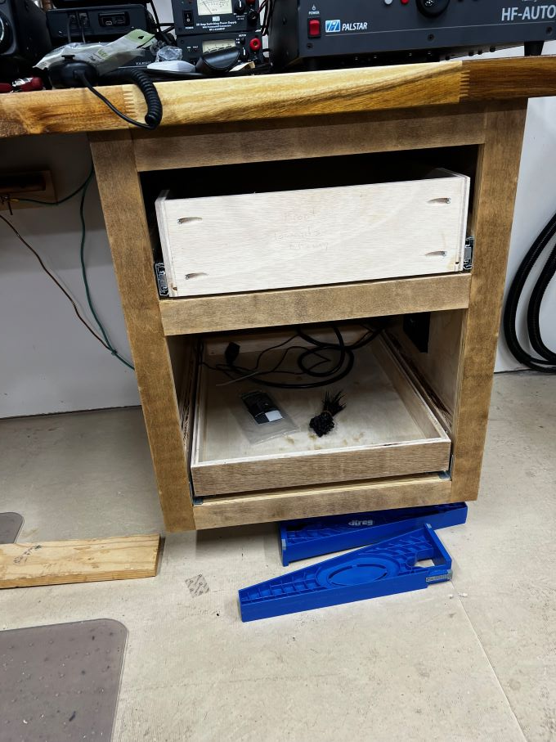
STARTING TO COME TOGETHER
Drawers made, slides in. Just need drawer fronts and hardware installed.

Slide 16
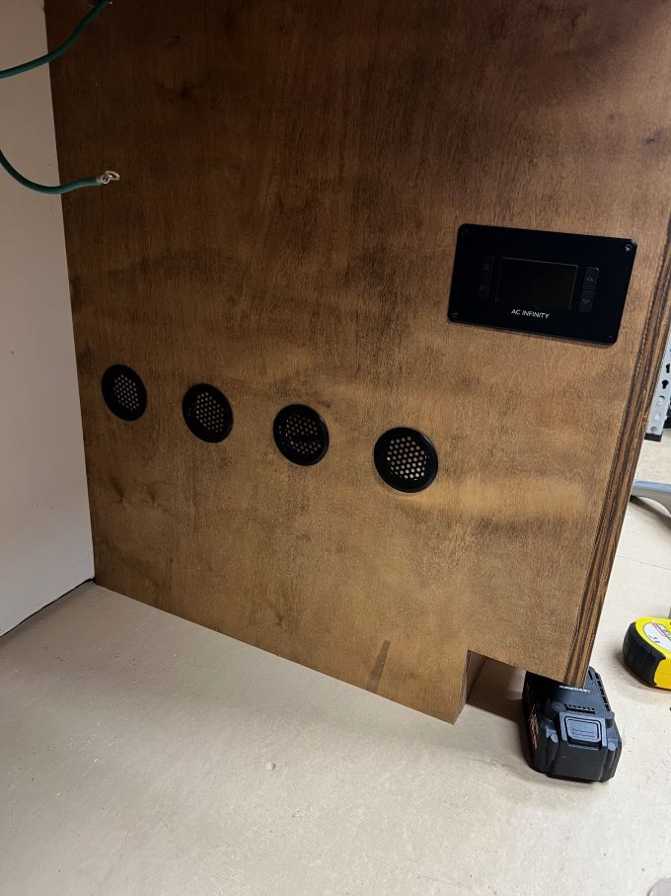
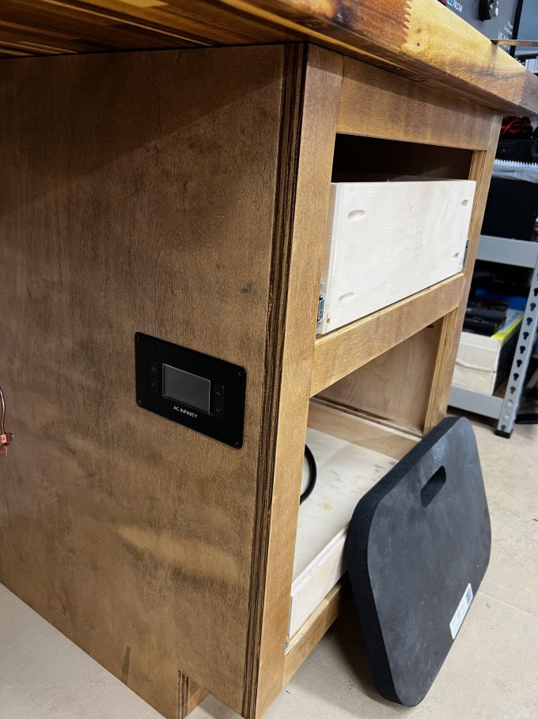
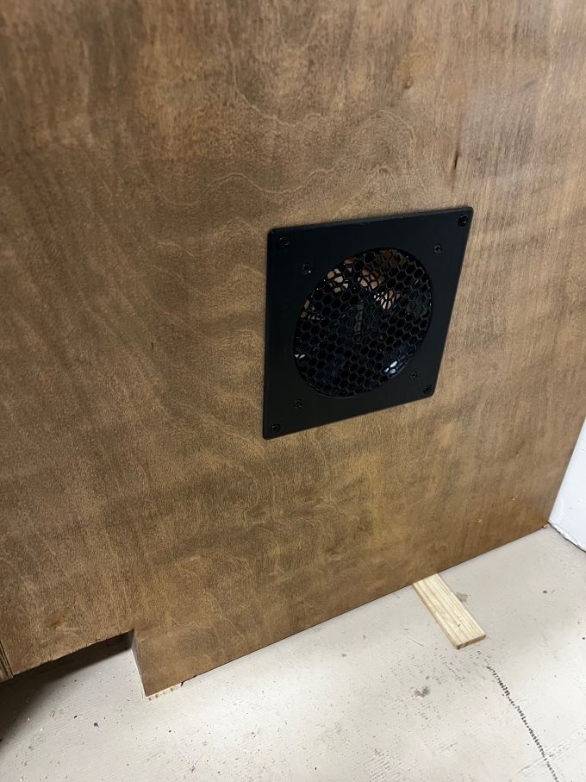
REMEMBER THE HOLES??
THE BOTTOM DRAWER WILL HOLD THE 1KW SS AMP AND NEEDS ADDITIONAL COOLING
INSTALLED AIR VENTS FOR 6” Airplate T3 # AI-APT3 52CFM fan w/remote temp sensing, temp set points & Auto or Manual control.
Temp Controller
w/temp set points & fan speeds
(4) 2” Vents
6” Sq Exhaust Fan

Slide 17
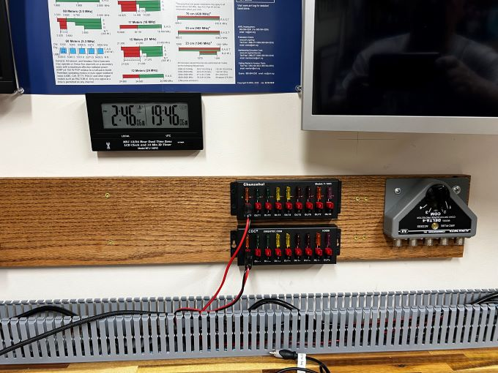
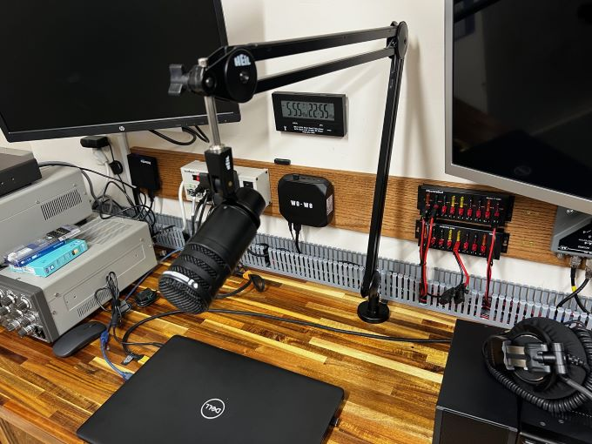
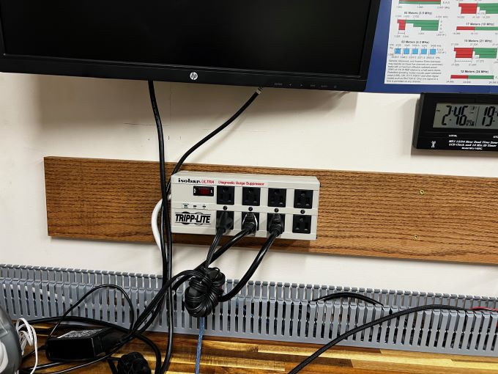
ESSENTIAL CONTROLS & FUNCTIONS FOR EASY ACCESS
NOTE THE PANDUIT CABLE TRAY TO KEEP WIRING ORGANIZED.
AC Power w/surge & short protection.
Panduit cable tray
DC Power Distribution
&
Antenna Switch
Heil boom and mic installed
Oak back board from L to R
Micro computer for Ham Clock
AC Pwr, Mini Computer, DC Pwr, Antenna Switch

Slide 18
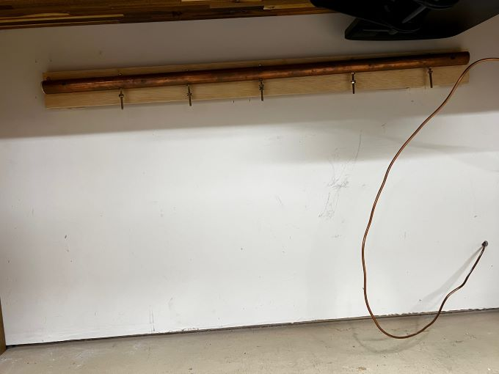
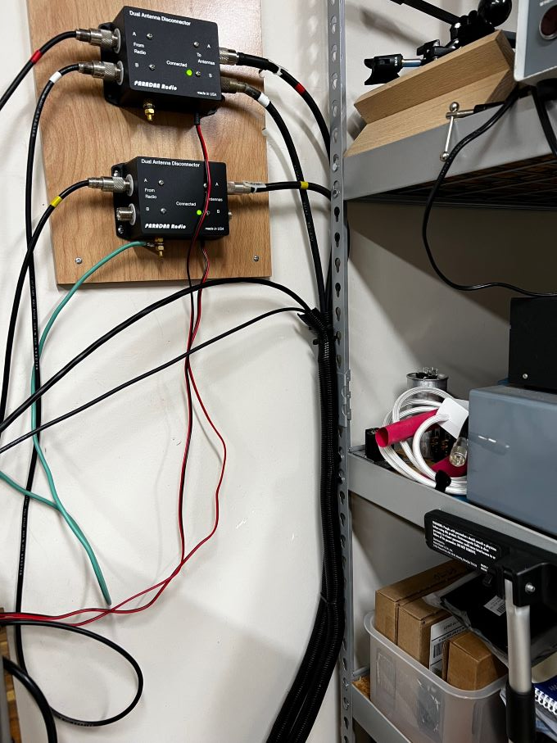
TWO MORE MESSES TO CLEAN UP
EQUIP COMMON GROUND AND ANTENNA GROUNDING RELAYS
#4 Solid Copper
Ground Buss 1” hard copper water pipe reinforced with wood dowel to prevent collapse. Brass screws
Two Paradan Dual Antenna Disconnect
Relays. Automatically Grounds Antennas when DC power is OFF

Slide 19
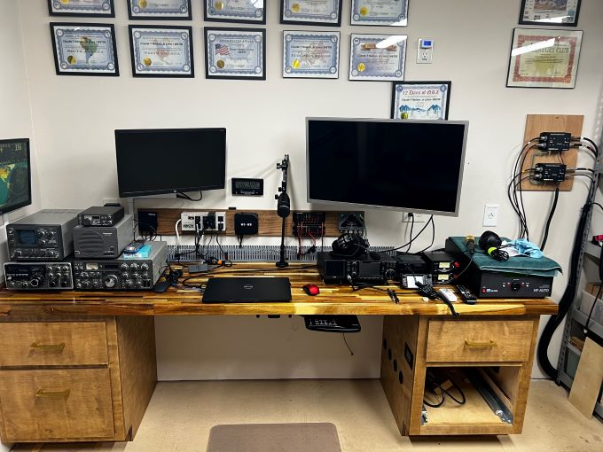
THINGS ARE STARTING TO COME TOGETHER
JUST A FEW DETAILS AND REFINEMENT

Slide 20
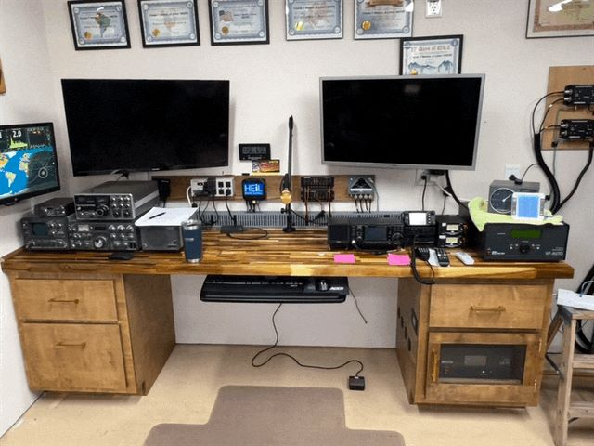
ALMOST THERE
Amp installed in bottom pull out draw. Fan and controller installed and working. Cables cleaned up. Glass window on Amp drawer door.
Note
Upgraded 2nd Monitor to match one on right.
Smaller monitor is now Ham Clock Monitor

Slide 21
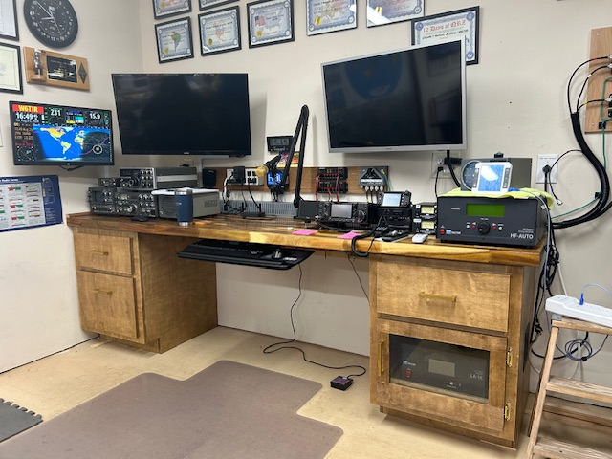
FEW MINOR DETAILS
CLEAN THIS UP

Slide 22
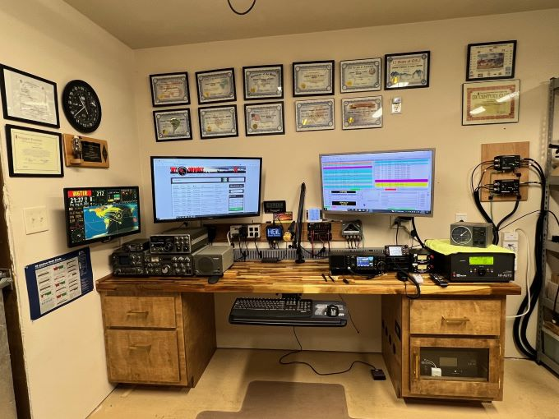
I’M CALLING IT “COMPLETE” Sept. 1st 2024
That is until I come up with further refinements.
Jerry says I need to put carpet in and install the baseboards and some more ¼ round to really clean things up.
“Yes Sgt Maj.”

Slide 23
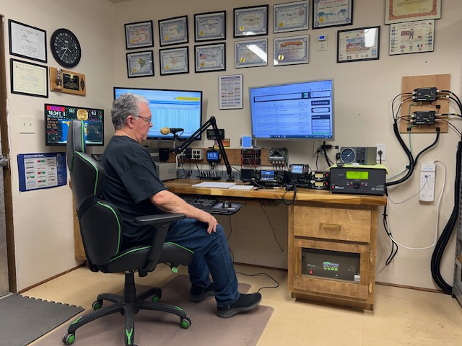
Enjoying the Fruits of Our Labor

Slide 24
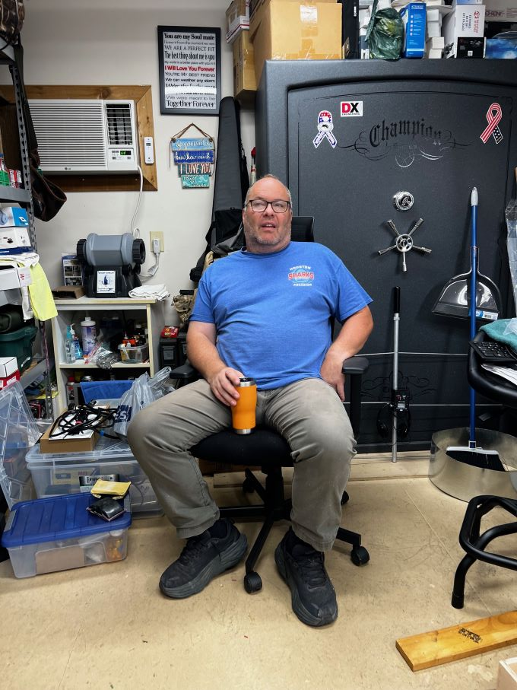
NONE OF THIS WOULD HAVE COME TO PASS WITHOUT
THE GUIDANCE, EXPERTISE, SUPPORT AND HELP OF MY
GOOD FRIEND JERRY CORNELL N5SGM-THANK YOU JERRY.
Total Investment
Materials & Equip
Approximately $650
Labor
Didn’t bother to count the hours!!!
3 months, at least 2 bottles of Monkey Shoulder
& some
Gurkhas & Guns
Special Thanks to
Marsh WA5UBO
For his help with the drawer faces.

